Slide 2
PROJECT LOCATION
Project begins at Garden Lane (East of I-4)
Project ends at County Line Road
18 miles

Slide 3
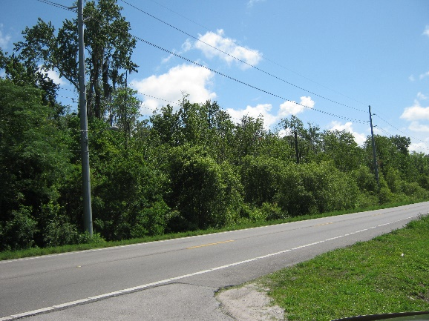
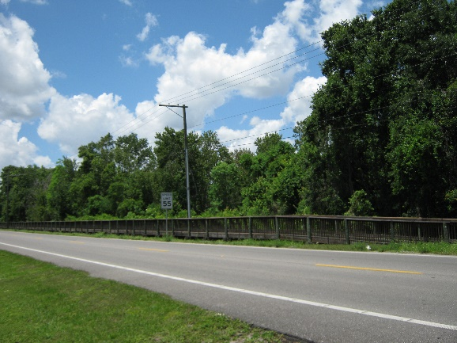
PROJECT DESCRIPTION
US 92 is:
Major east-west roadway through Hillsborough County
Important in Tampa Bay area regional transportation network
Project will increase capacity and improve safety
Four-lane improvement from Garden Lane to Mobley Street and from Park Road to County Line Road
No-build through Plant City

Slide 4
PD&E STUDY PROCESS
Re-evaluation of the original PD&E Study approved by the Federal Highway Administration on March 24, 1994
Re-evaluation of proposed improvements includes:
Costs
Engineering aspects
Environmental aspects
Public and agency input

Slide 5
PROJECT NEED
Capacity
Future estimated traffic volumes will cause US 92 to operate below desired standards
Transportation Planning
US 92 from US 301 to CR 579 (Mango Road) and from Park Road to County Line Road
Included in the Imagine 2040: Hillsborough County MPO Long Range Transportation Plan Cost Feasible Plan
Safety
Crash data shows that the average five-year crash rate is higher than the statewide average
Socioeconomic Demand
Projected regional growth will increase traffic

Slide 6
RECOMMENDED BUILD ALTERNATIVE
Four typical sections are proposed for the project:
Garden Lane to west of I-4 overpass and east of I-4 overpass to east of Crow Wing Drive (purple area)
West of I-4 overpass to east of I-4 overpass (yellow area)
East of Crow Wing Drive to Edwards Street and east of Park Road to County Line Road (orange area)
Edwards Street to Mobley Street (blue area)
No-build
Mobley Street to west of Park Road (green area)
Segments 5-9, and 11 (Typical Section B - Orange)
Segment 10 (No-build alternative - Teal)

Slide 7
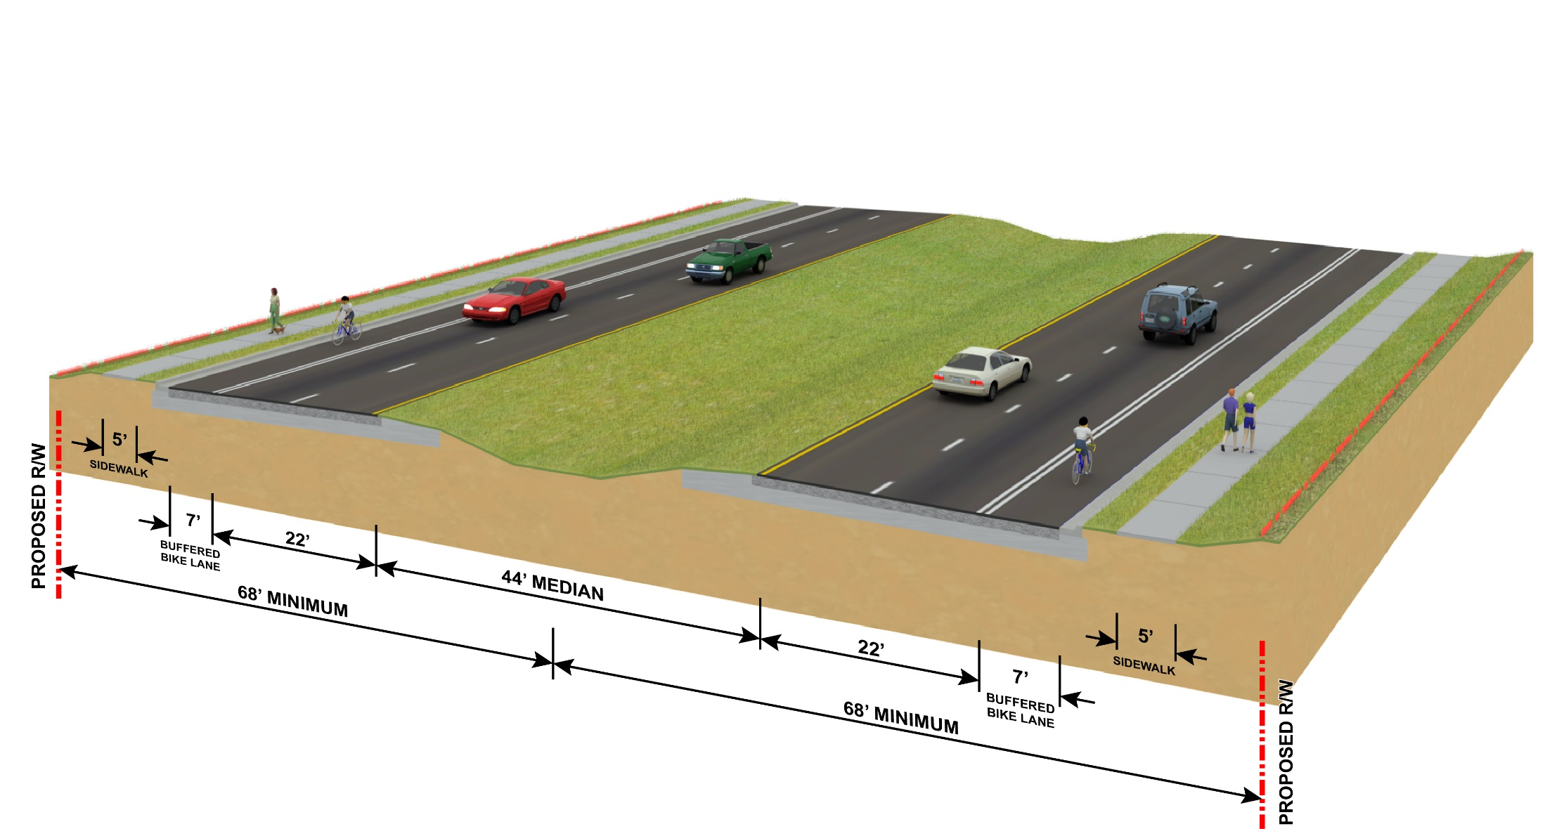
RECOMMENDED BUILD ALTERNATIVE
Garden Lane to west of I-4 overpass
East of I-4 overpass to east of Crow Wing Drive

Slide 8
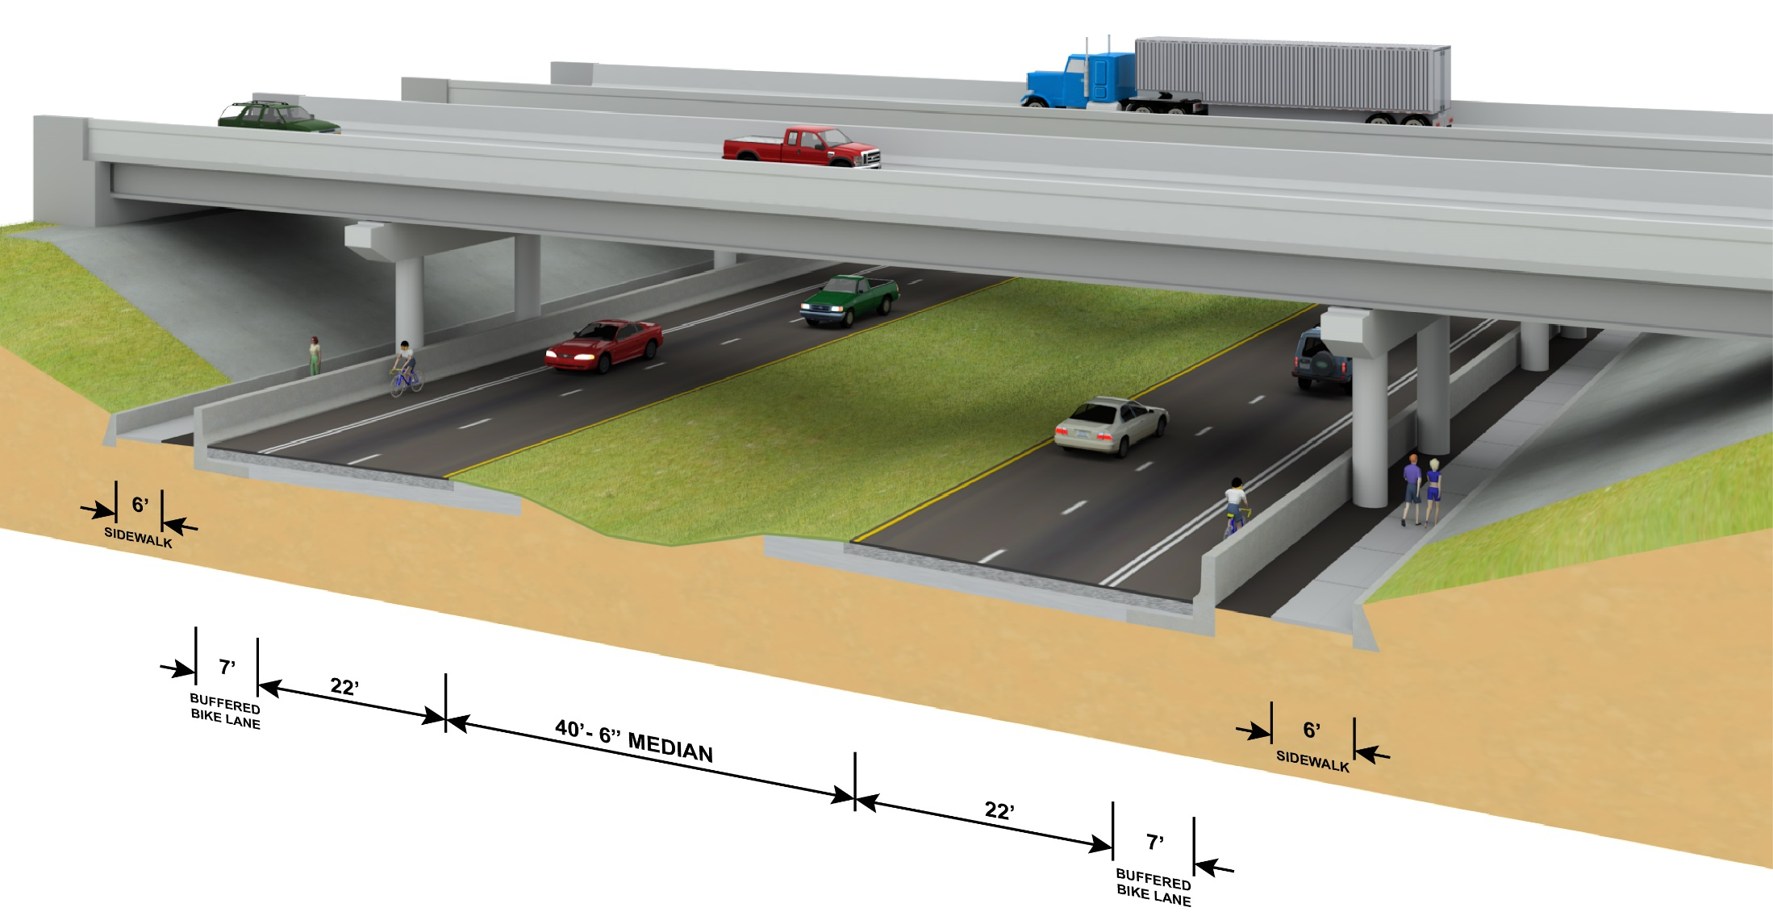
RECOMMENDED BUILD ALTERNATIVE
West of I-4 overpass to east of I-4 overpass

Slide 9
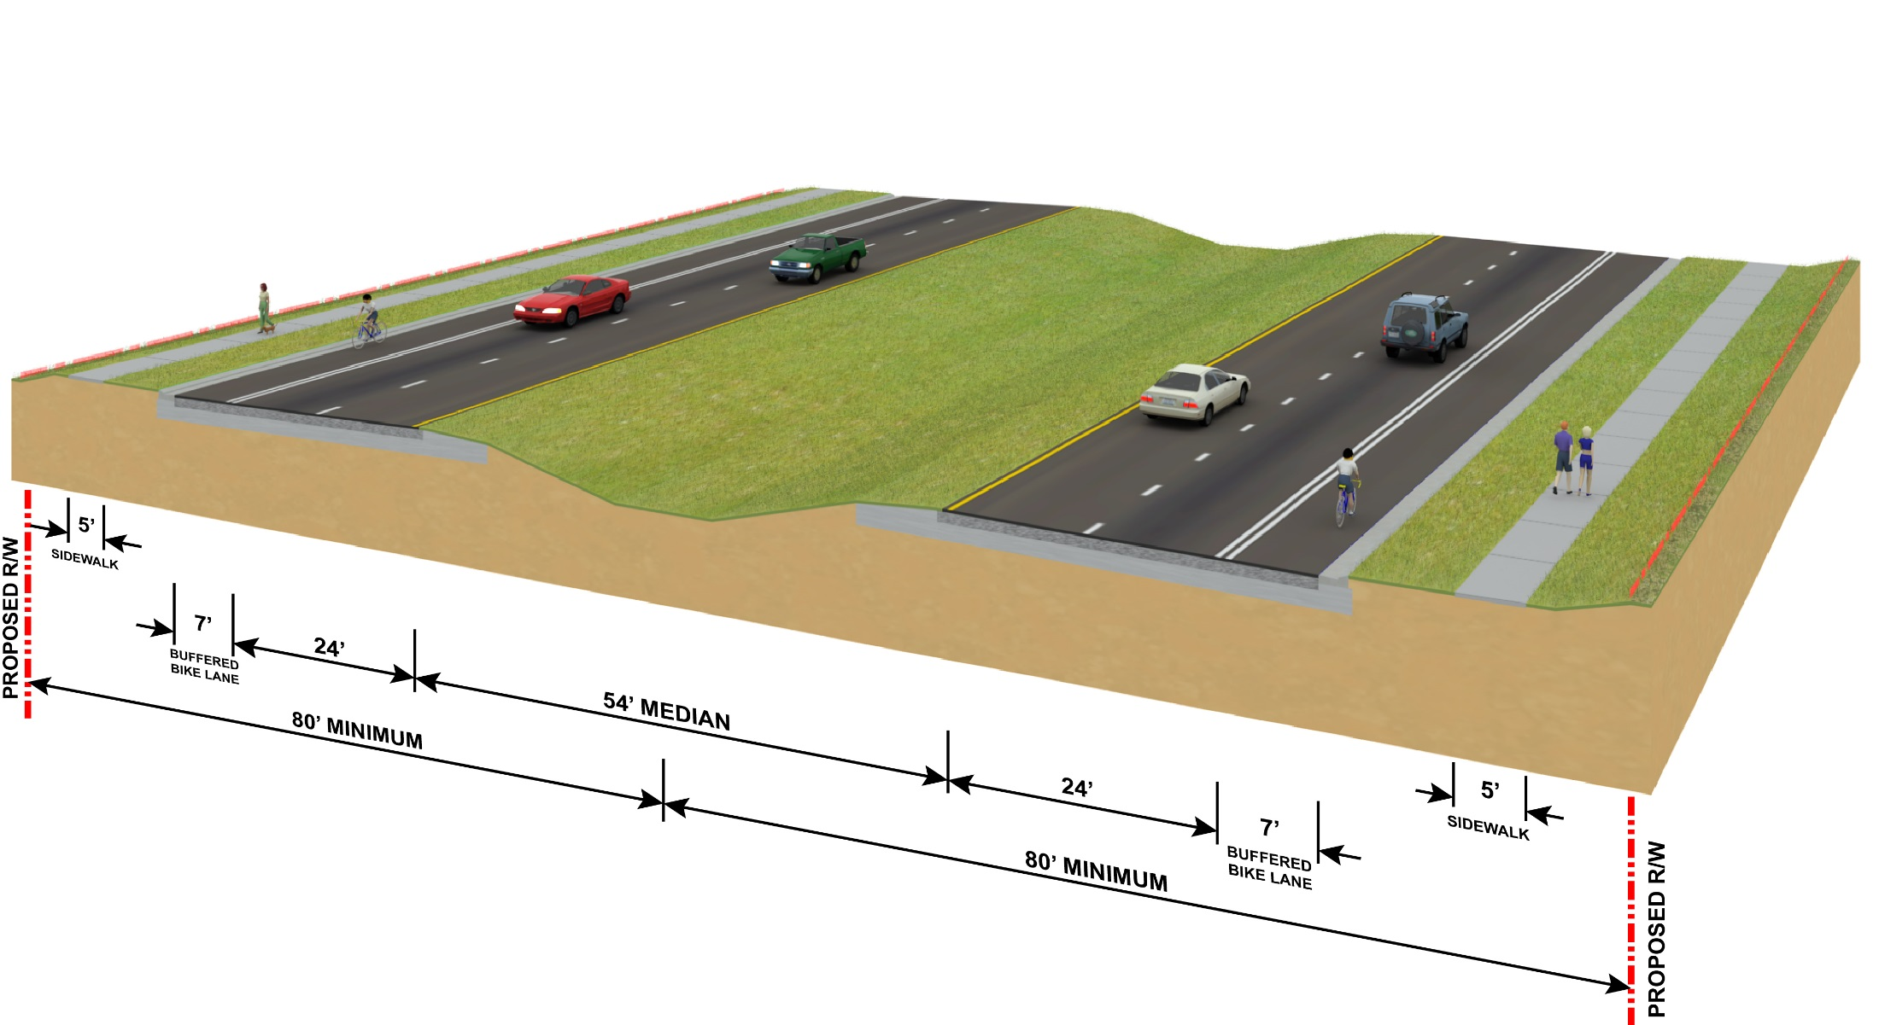
RECOMMENDED BUILD ALTERNATIVE
East of Crow Wing Drive to Edwards Street
East of Park Road to County Line Road

Slide 10
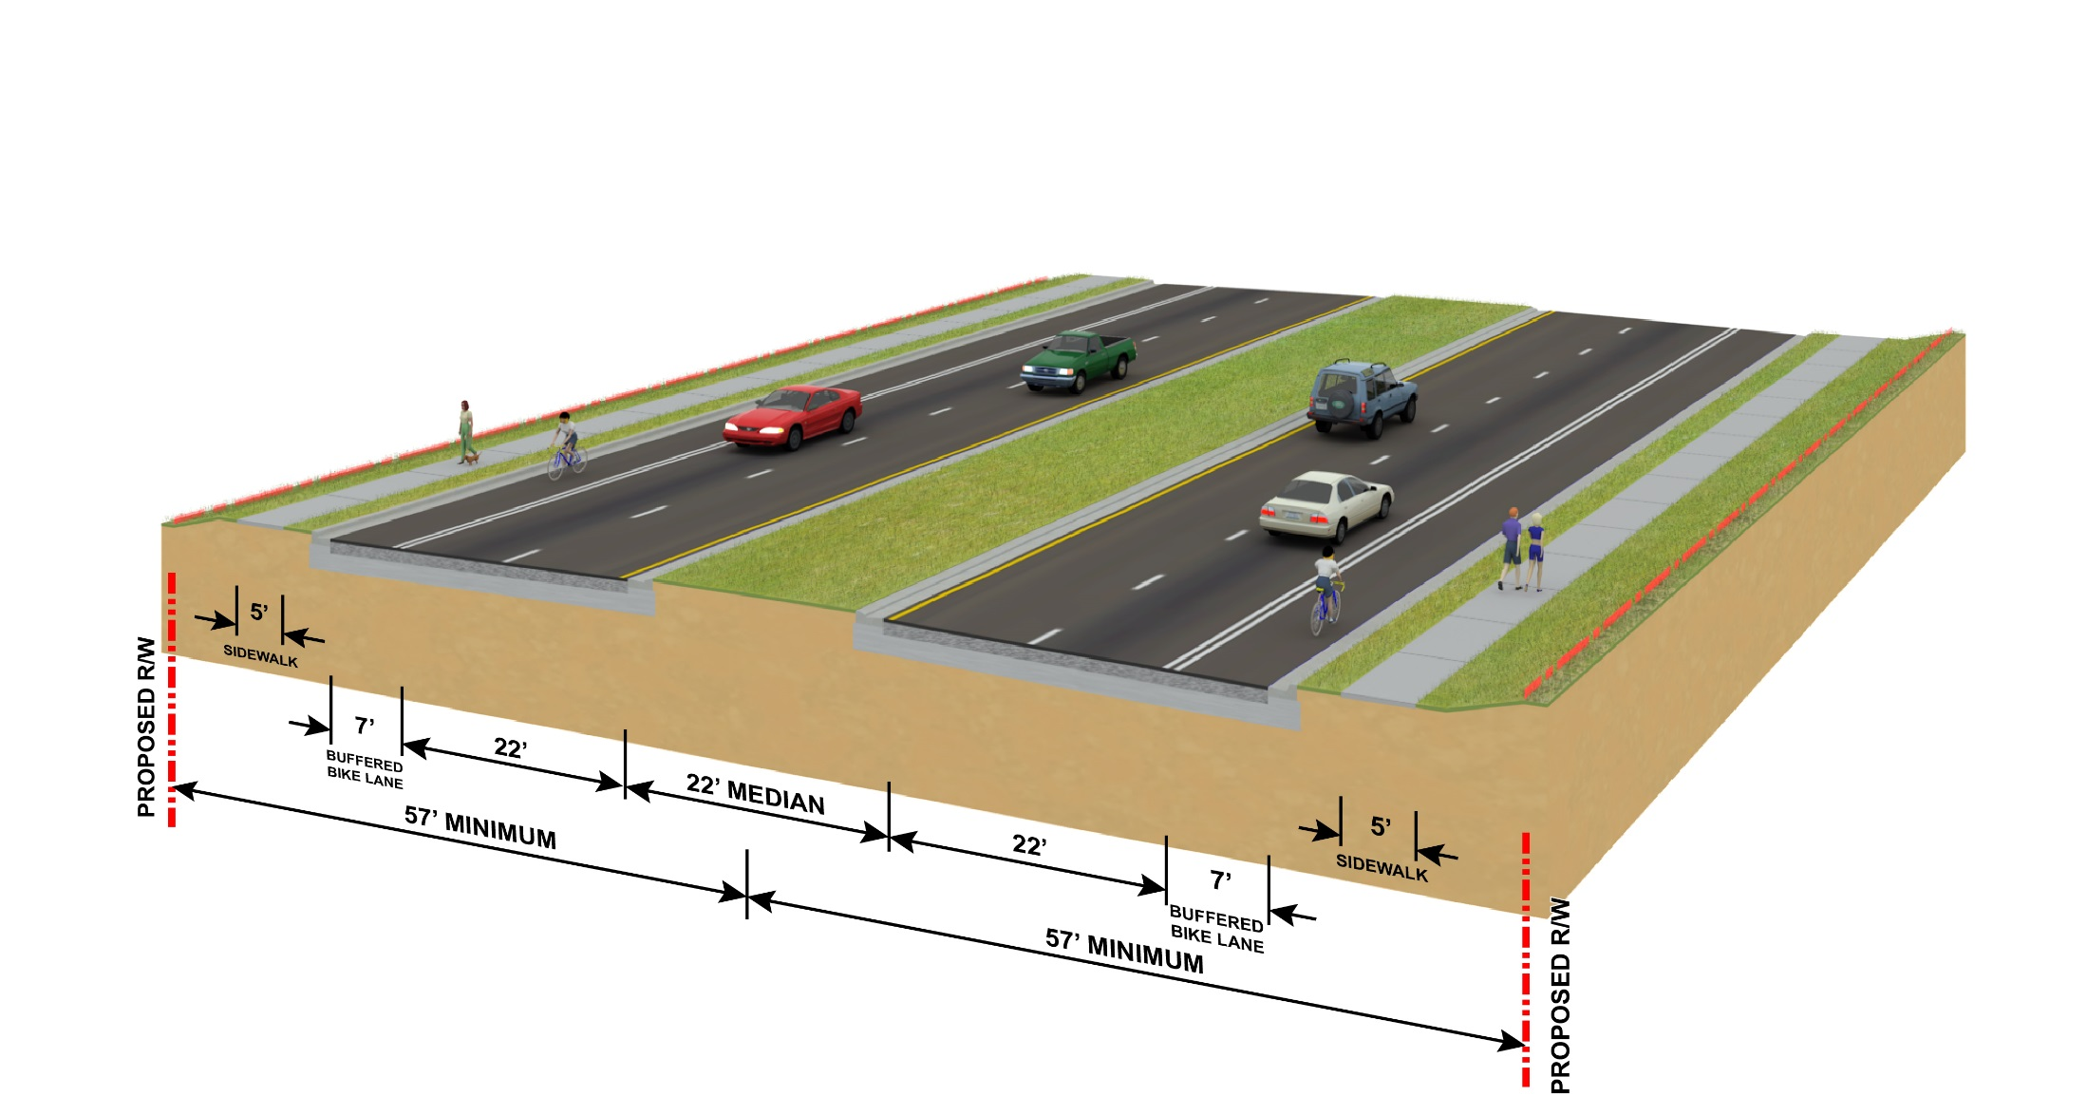
RECOMMENDED BUILD ALTERNATIVE
Edwards Street to Mobley Street

Slide 11
ACCESS MANAGEMENT
Combination of directional and full median openings proposed
Directional median openings allow some turns
Full median openings allow turns in all directions
Driveway and crossroad locations considered
Access Management Class 5 spacing criteria
Class | Medians | Median Openings |  | Signal | Connection
 |  | Full | Directional |  | More than 45 mph posted speed | 45 mph and less posted speed
5 | Restrictive | 2,640’ At greater than 45 mph posted speed | 660’ |  | 440’ | 245’
 |  | 1,320’ At 45 mph or less posted speed

Slide 12
NO-BUILD ALTERNATIVE
Advantages
No acquisition of right-of-way
No design, right-of-way or construction costs
No inconvenience to the public during construction
No construction impacts to natural, physical, and social environment
Disadvantages
Increased traffic congestion
Emergency vehicle access is degraded
Does not improve pedestrian or bicyclist safety
Increased user costs due to congestion
Not consistent with the identified needs of the corridor by the Hillsborough Metropolitan Planning Organization

Slide 13
BUILD ALTERNATIVE
Advantages
Reduced traffic congestion and intersection delay
Reduced potential for crashes
Reduced vehicle emissions
Improved emergency vehicle response
Improved pedestrian and bicyclist safety
Consistent with the identified needs of the corridor by the Hillsborough Metropolitan Planning Organization
Disadvantages
Additional right-of-way needed
Design, right-of-way, and construction costs
Inconvenience to the public during construction
Construction impacts to natural, physical, and social environment

Slide 14
FUNDING SCHEDULE
US 92 from Kingsway Road to McIntosh Road
Phase | Funding Document | Fiscal Year | Funding Amount ¹
Design | FDOT Five-Year Adopted Work Program FY 2016-2021 | 2017 | $2,042,000
Note:
Year of expenditure cost

Slide 15
FUNDING SCHEDULE
US 92 from McIntosh Road to
SR 566 (Thonotosassa Road)
Phase | Funding Document | Fiscal Year | Funding Amount ¹
Design | FDOT Five-Year Adopted Work Program FY 2016-2021 | 2017 | $5,446,000
Note:
Year of expenditure cost

Slide 16
PROJECT STATUS
Re-evaluation began January 2015
Small group meetings are currently planned with local community organizations
Public hearing - late fall of 2016
PD&E study re-evaluation completion - end of 2016

Slide 17
COMMENTS/QUESTIONS
http://active.fdotd7studies.com/sr600/i4-to-county-line/

